Slide 2
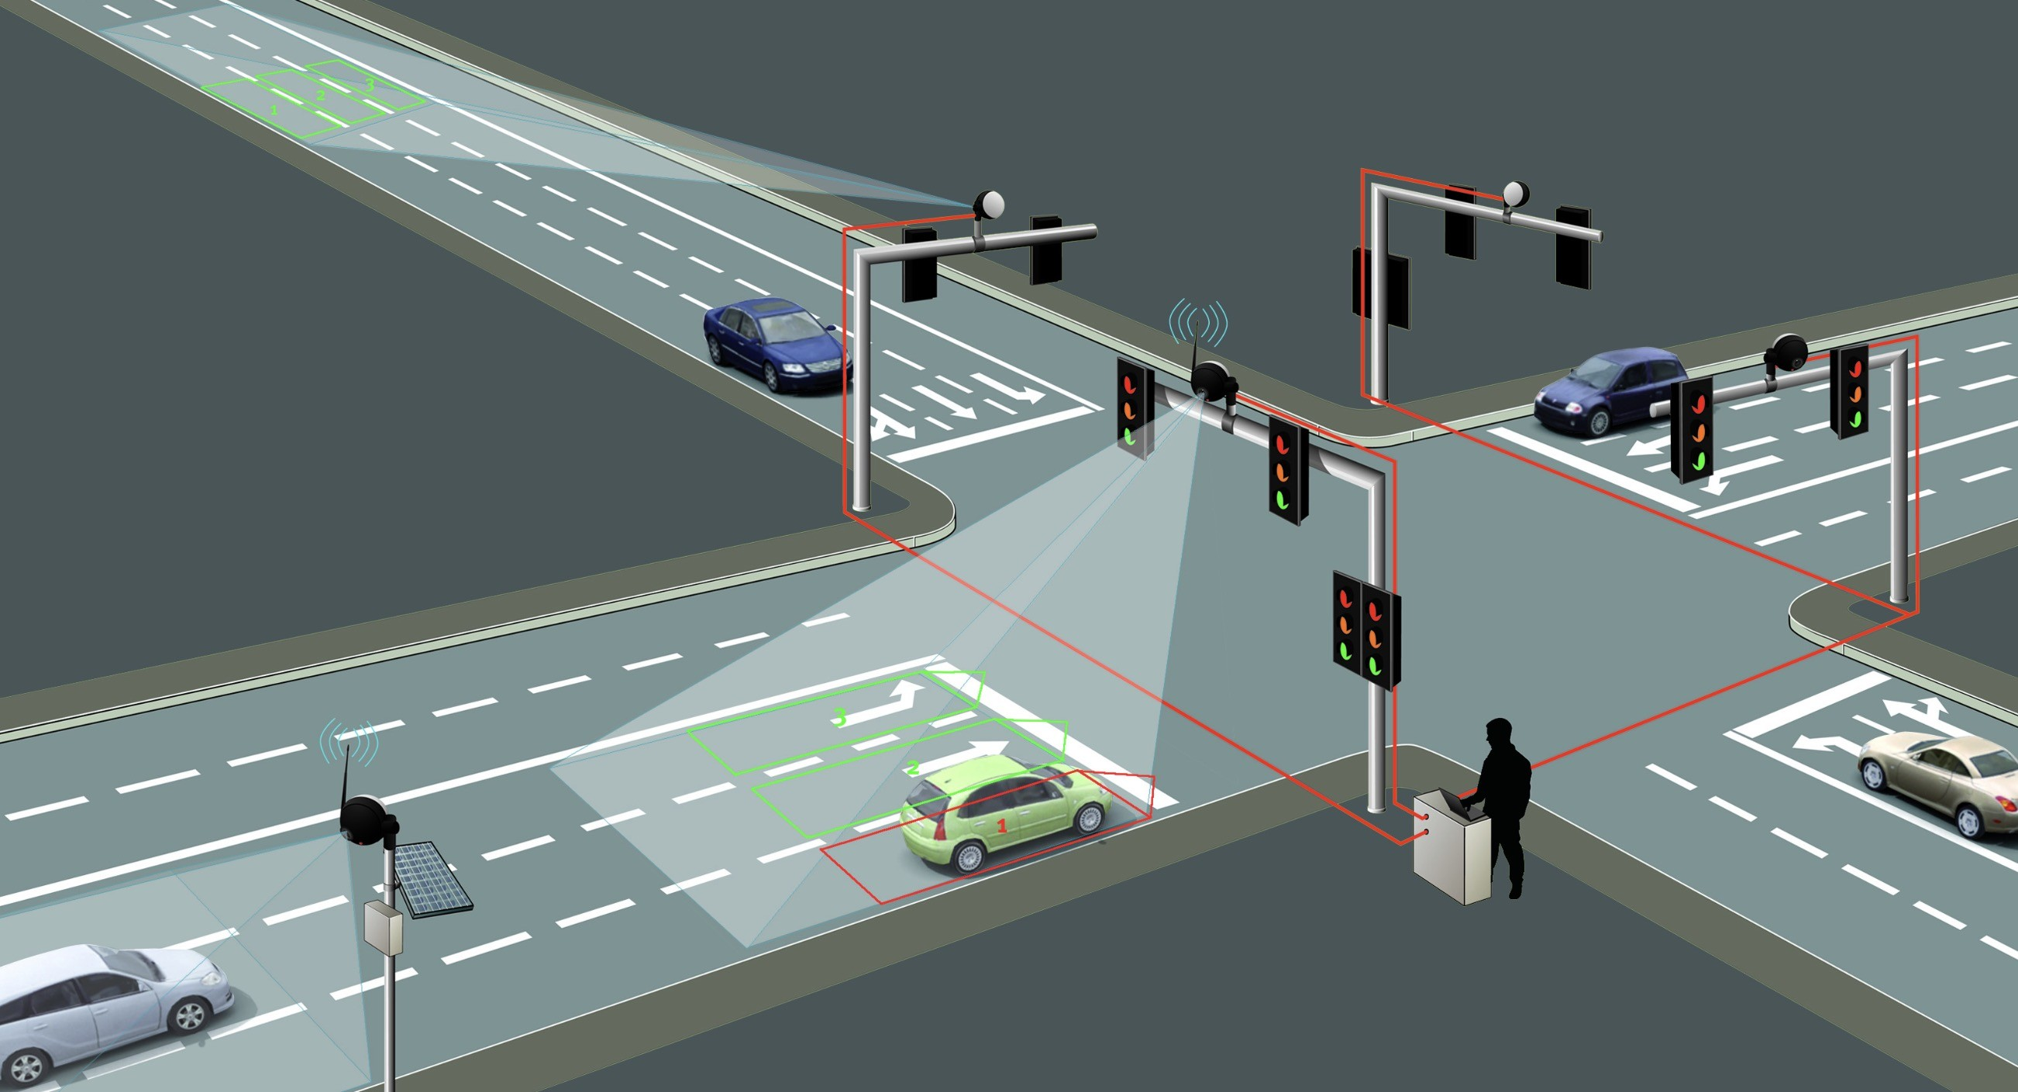
Density Based Smart Traffic Light System
1
A Smart Traffic Light System using ESP32 and Infrared Sensors
A practical demonstration of automation and IoT in traffic management
2

Slide 3
Introduction
Traffic congestion is a major challenge in modern cities.
Traditional traffic lights operate on fixed timers, often failing to adapt to real traffic conditions.
This project introduces a smart traffic light system that uses ESP32 and IR sensors to dynamically control signals
based on vehicle presence.

Slide 4
1
Detect vehicles automatically using infrared sensors.
Control traffic lights intelligently to reduce waiting time.
Demonstrate how microcontrollers and sensors can be applied in real-world automation projects.
2
Objectives
3

Slide 5
ESP32 Development Board (the brain of the system).
Infrared Obstacle Sensors (vehicle detection).
LEDs (Red, Yellow, Green for each road).
Perfboard, jumper wires, hot glue for assembly.
1
2
Components Used
3
4

Slide 6
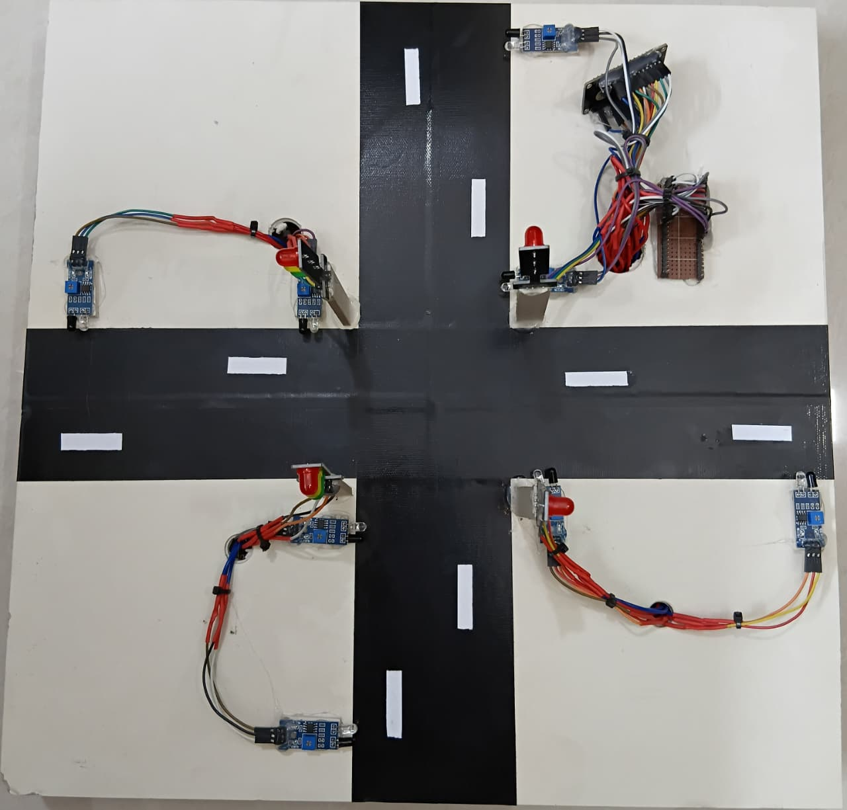
At a glance our project

Slide 7
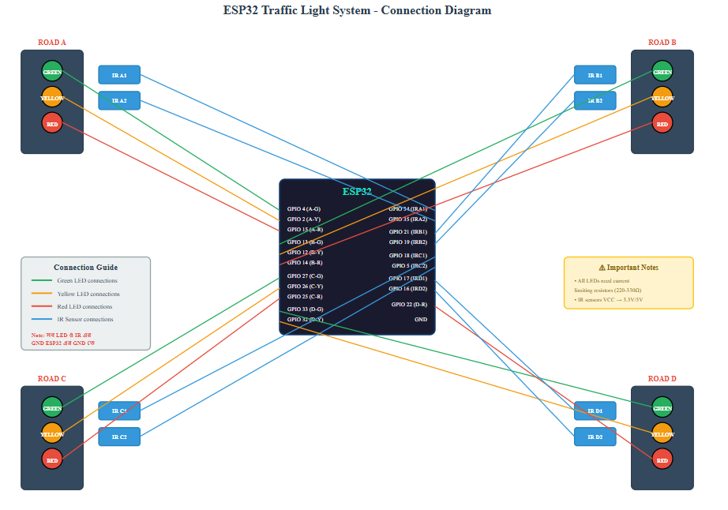
Circuit Diagram

Slide 8
Code Logics
GPIO pins are defined for all LEDs and sensors at the beginning of the program.
Using pinMode(), sensor pins are set as INPUT and LED pins are set as OUTPUT.
Sensor values are continuously read with digitalRead().
Based on sensor input, LEDs are controlled with digitalWrite() to switch between Green, Yellow, and Red lights.
Example: If a car is detected on Road A, the Green LED for Road A turns ON while other roads remain Red.

Slide 9
Working Principle
Infrared sensors detect whether vehicles are present at each road.
The ESP32 processes these signals and decides which road should get priority.
Traffic lights change dynamically: Green allows vehicles to pass, Yellow provides a short transition, and Red stops vehicles.
This cycle repeats continuously, ensuring smoother traffic flow compared to fixed timers.

Slide 10
Advantages
The system reduces unnecessary waiting time at traffic signals, making driving more efficient.
It saves energy by keeping lights ON only when needed.
The design is scalable and can be applied to smart city infrastructure.
It is cost-effective and easy to build with readily available components.

Slide 11
Limitations
The system relies only on IR sensors, which may give false readings in bright sunlight or dusty conditions.
It is a prototype model and not yet suitable for full-scale road intersections.
A stable power supply is required for continuous operation.

Slide 12
Innovatives
Pedestrian Crossing Integration
A push button or sensor can be added for pedestrians. When pressed, the system will temporarily switch the traffic light to red, ensuring safe pedestrian crossing.
Solar Powered Traffic Lights
The entire system can be powered by solar panels, making it eco‑friendly and suitable for rural or remote areas where electricity supply is limited.
IoT Connectivity
The ESP32 can send live traffic data to the cloud using Wi‑Fi. A mobile app or dashboard can then display real‑time traffic conditions, enabling smart city monitoring.
Accident Alert System
If a vehicle is detected as stuck for a long time, the system can send an alert to authorities. This feature can help identify accidents or breakdowns early.

Slide 13
Challenges
Pin Conflict
I mistakenly assigned the same GPIO pin to two different components. It took me hours to debug why one LED wasn’t working — later I found it was clashing with an IR sensor.
Loose Jumper Wires
During testing, some jumper wires got loose and caused random LED blinking. I had to rewire everything and eventually solder the connections for stability.
Hot Glue Blocking Sensor
While securing the IR sensors with hot glue, a drop accidentally covered part of the sensor lens. It stopped detecting vehicles until I carefully removed the glue.
Code Logic Overlap
My initial if-else conditions were conflicting — multiple roads were getting green signals at once. I had to restructure the logic and test each case separately.
Perfboard Soldering Mistake
One LED wasn’t lighting up even though the code was correct. Later I found a cold solder joint on the perfboard and had to re-solder it.

Slide 14
Conclusion
This project demonstrates how ESP32 and IR sensors can be combined to create an intelligent traffic light system.
It highlights the potential of IoT and automation in solving real-world problems.
Future improvements could include integration with cameras, cloud-based monitoring, and AI for advanced traffic prediction.

Slide 15
Thank You For Your Kind Attention

